Slide 1
STUDENT MANAGEMENT SYSTEM
Submitted by,
Ankitha K M

Slide 2
About Java Swing
Swing is a GUI widget toolkit for java,that provide the ability to create GUI components.
It is part of Oracle’s Java Foundation Classes-an API for providing a graphical user interface for java programs.Swing was developed to provide a more sophisticated set of GUI components than the earlier Abstract window toolkit.

Slide 3
Login Form
Admin can only login into this by entering his/her login credentials.
Username
Password
Login and cancel button.

Slide 4
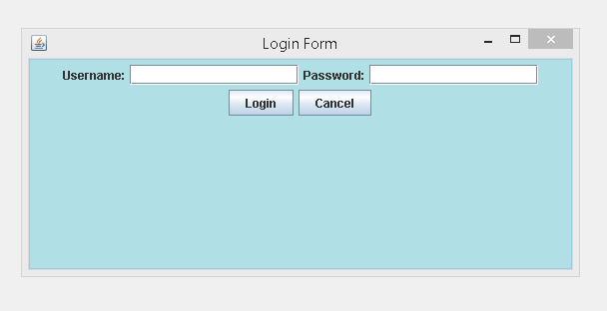
login

Slide 5
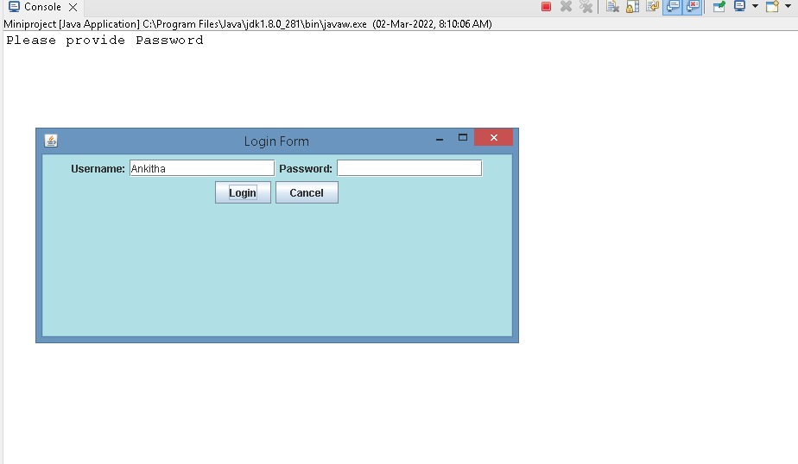
login

Slide 6
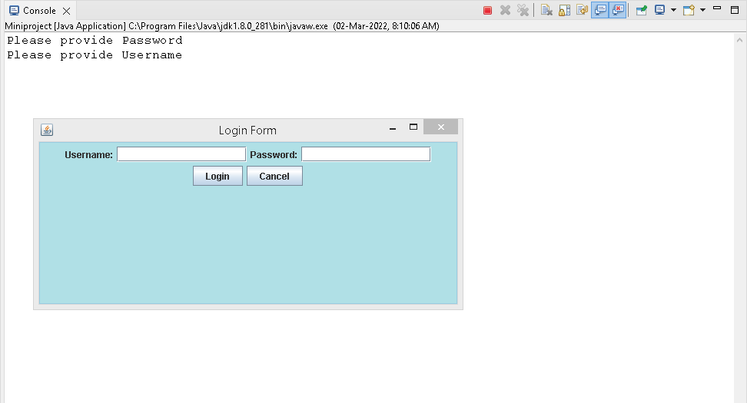
login

Slide 7
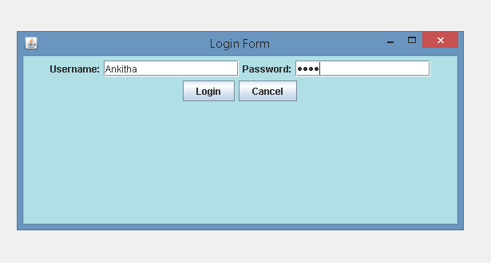
login
Once after entering valid inputs,will get the Menu page.

Slide 8
Menu
Here we will have buttons related to student personal and academic details.
Register new student.
Register Student Personal Details.
View Student Personal Records.
Student Academic details.
Logout.

Slide 9
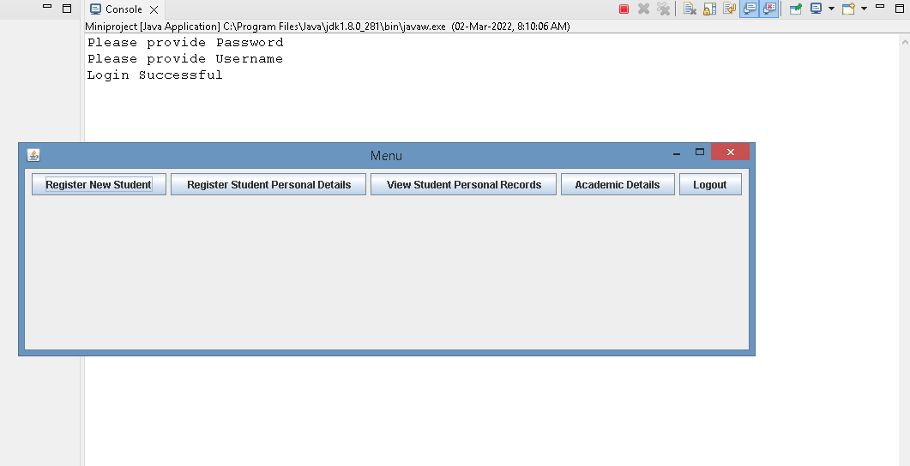
menu

Slide 10
Register New Student
TextFields-Firstname,Lastname,Gender,DOB,Contact Number.
TextArea-Address
Button-Register,View,Reset,Back.

Slide 11
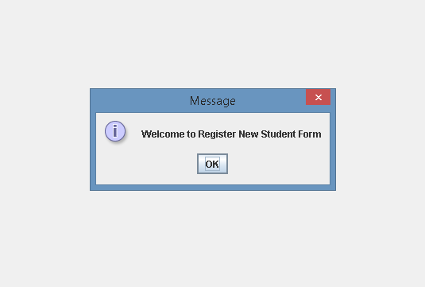
Register new student

Slide 12
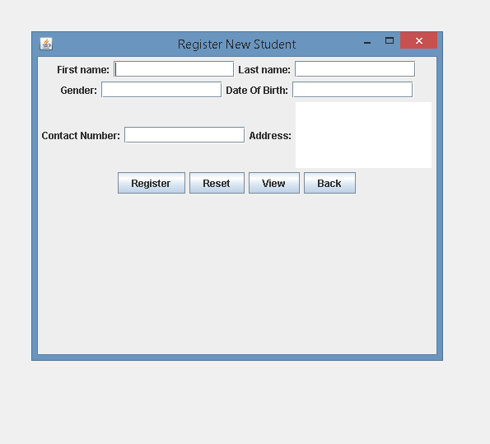
Register new student

Slide 13
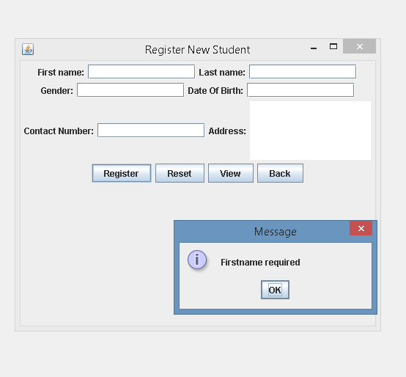
Register new student

Slide 14
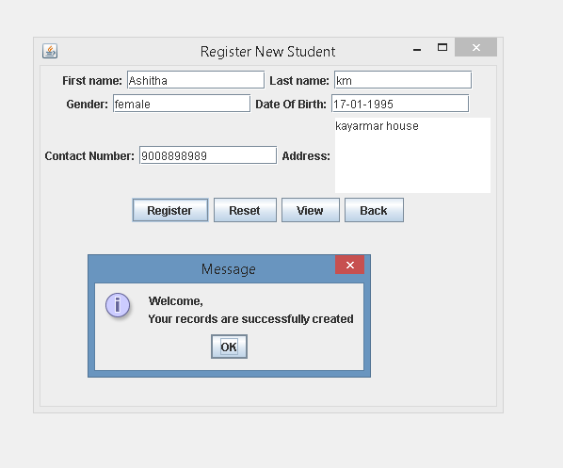
Register new student

Slide 15
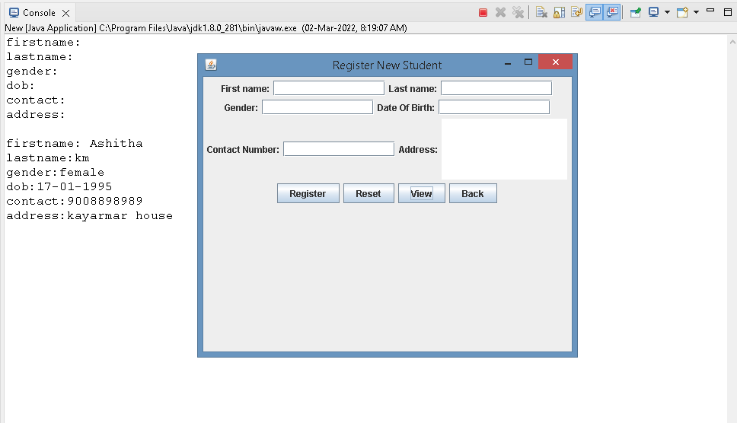
Register new student

Slide 16
Student Personal Details
Here student personal details will be registered.

Slide 17
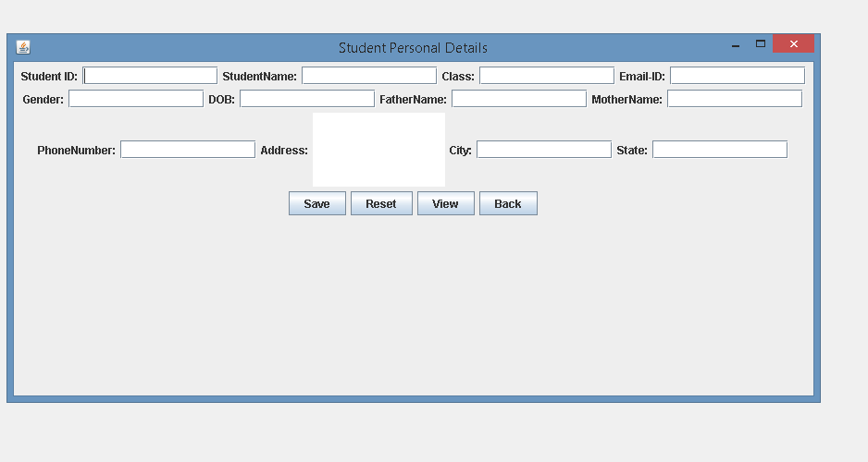
Student personal details

Slide 18
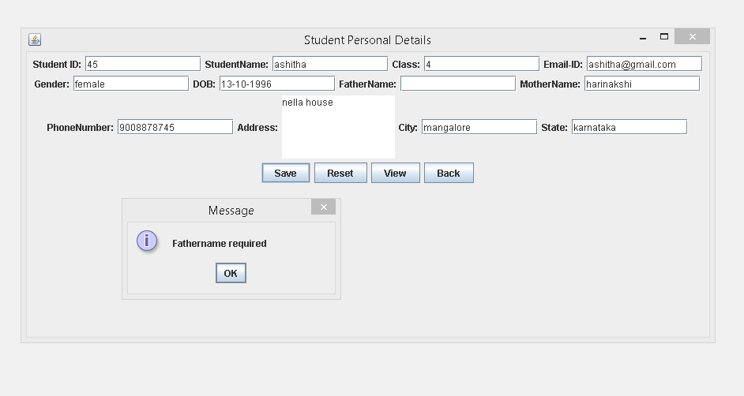
Student personal details

Slide 19
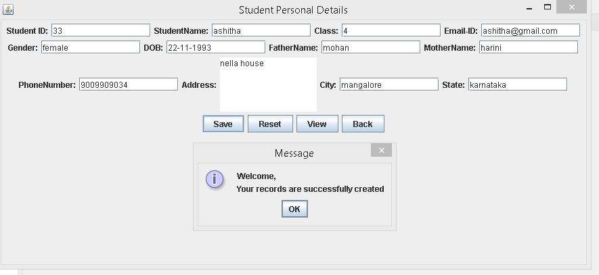
Student personal details

Slide 20
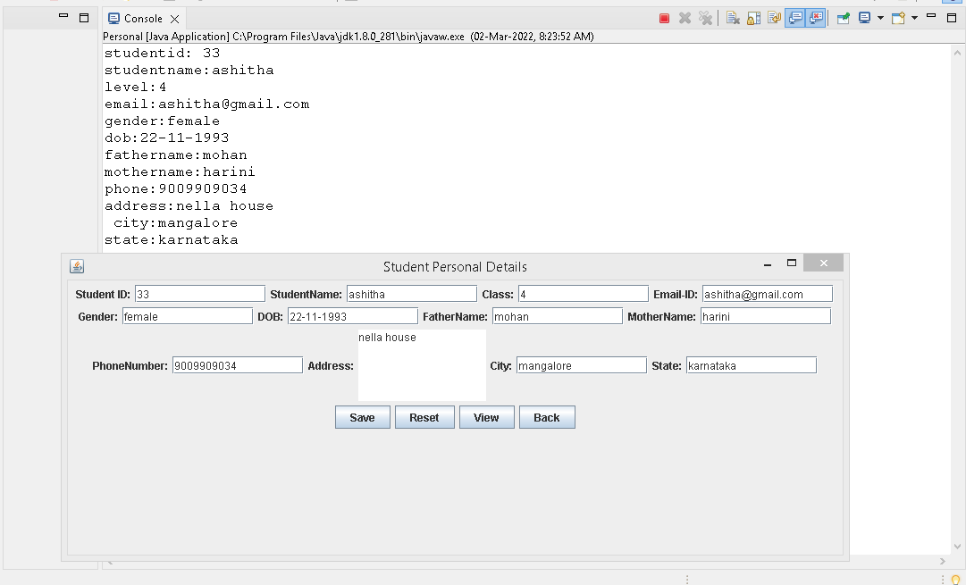
Student personal details

Slide 21
View Student Records
Suppose admin wish to view his/her personal registered records then by entering SID ,admin will able to get details.

Slide 22
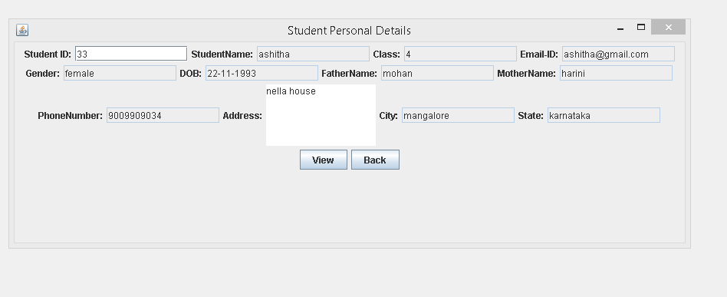
View student record

Slide 23
Academic Details
Here respective marks need to be entered for particular subject.

Slide 24
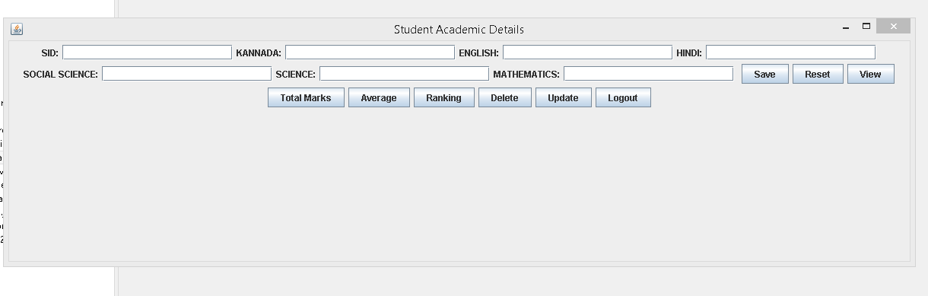
Academic details

Slide 25
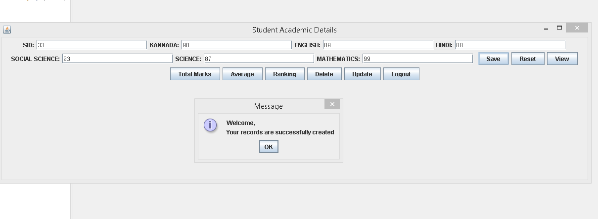
Academic details

Slide 26
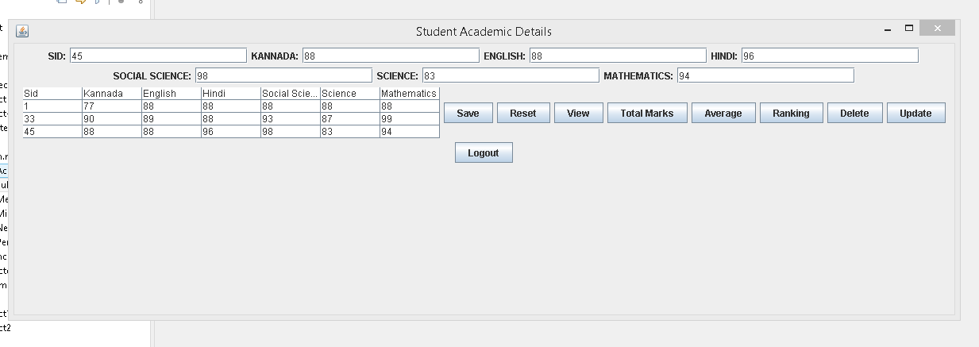
Academic details

Slide 27
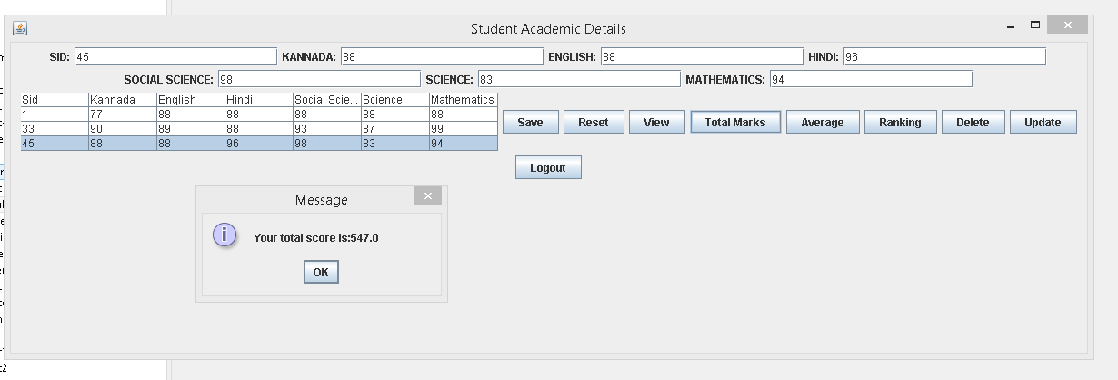
Academic details

Slide 28
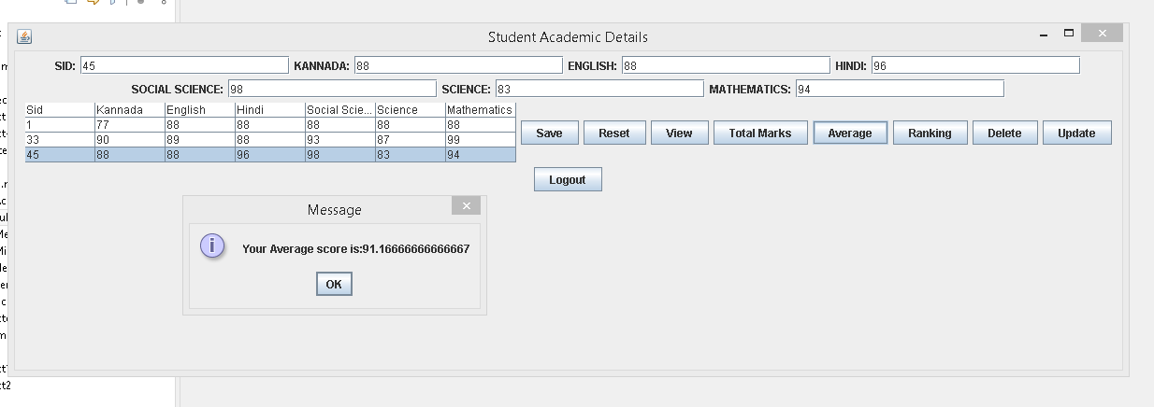
Academic details

Slide 29
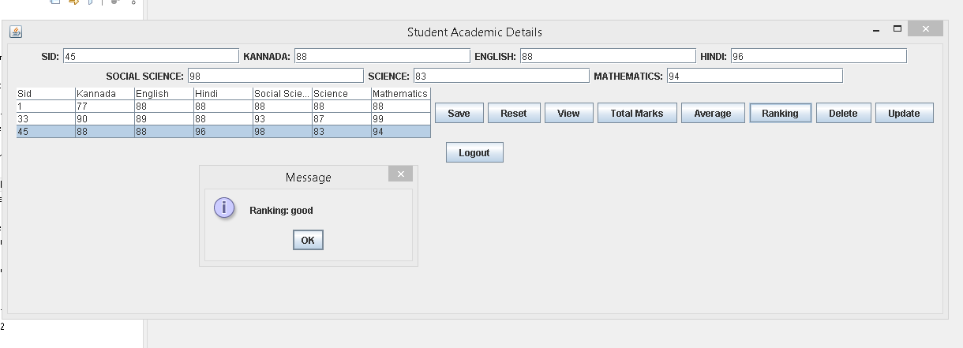
Academic details

Slide 30
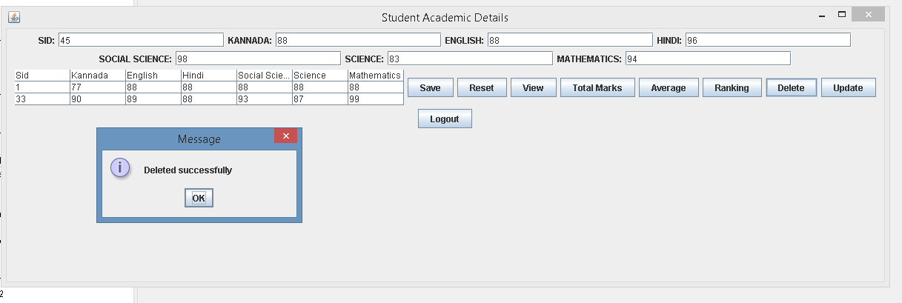
Academic details

Slide 31
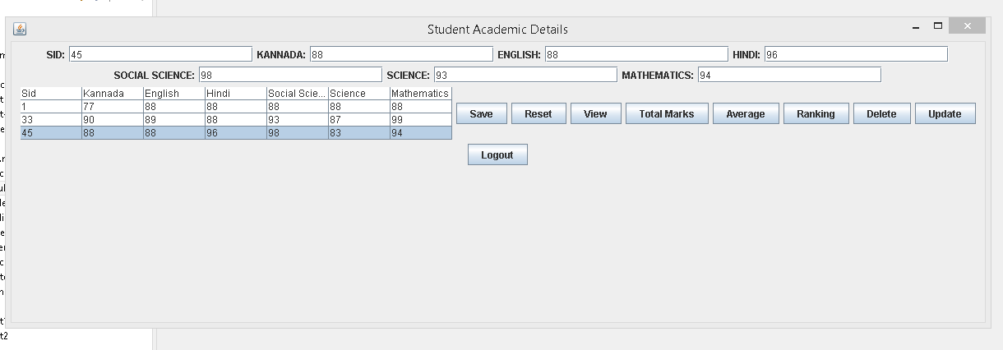
Academic details

Slide 32
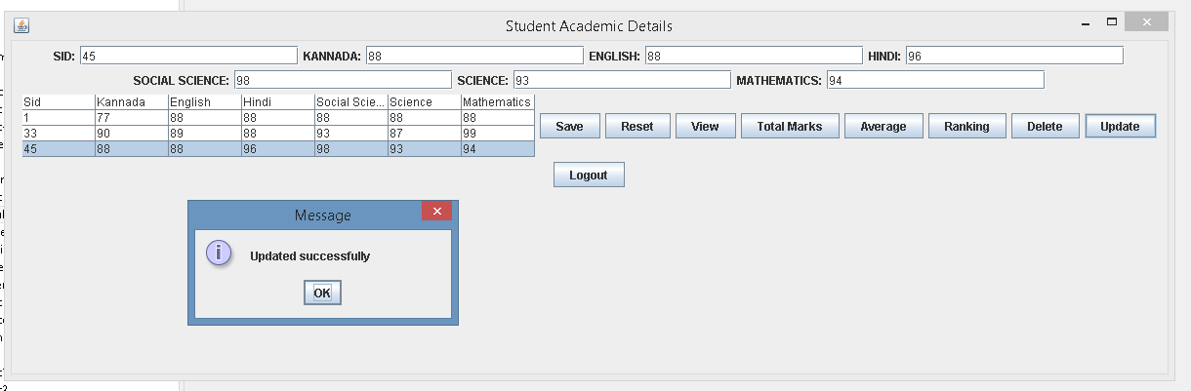
Academic details

Slide 33
LogOut
Admin can logout from the page.

Slide 34
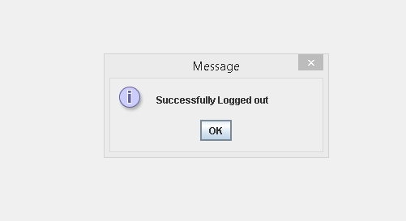
Logout page

Slide 35
THANKYOU

